Slide 1
Transform Education
Peter Kilcoyne Esam Baboukhan

Slide 2

Transform Education
Who we are?
Lessons for the new normal from 10 years of blended learning
Getting the most from Microsoft365
How can Transform Education support you?

Slide 3
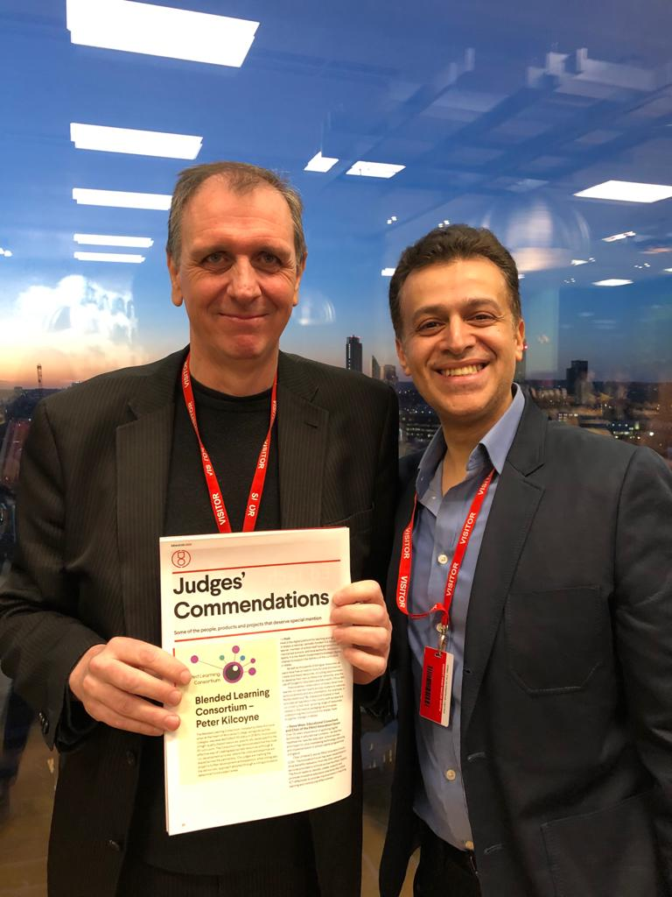
Who we are
Peter Kilcoyne Led teams that won TES and AoC awards for Blended Learning at HOW College Twice winner of EdTech 50 award IMS Global Impact Award Set up and led BLC for 5 years
Esam Baboukhan Pearson teacher of the year silver award EdTech 50 award
Team of Associates including some of the most outstanding digital learning practitioners in the sector

Slide 4
Lessons for the new normal from 10 years of blended learning
A clear and simple model that everyone buys into and understands
The right pedagogy
Effective CPD and ongoing support
Monitoring participation and quality
Clear roles and responsibilities

Slide 5
A clear and simple model
e.g. SOLA Plus
50% F2F
25% Live online (synchronous)
25% Tracked structured independent study online (asynchronous)

Slide 6
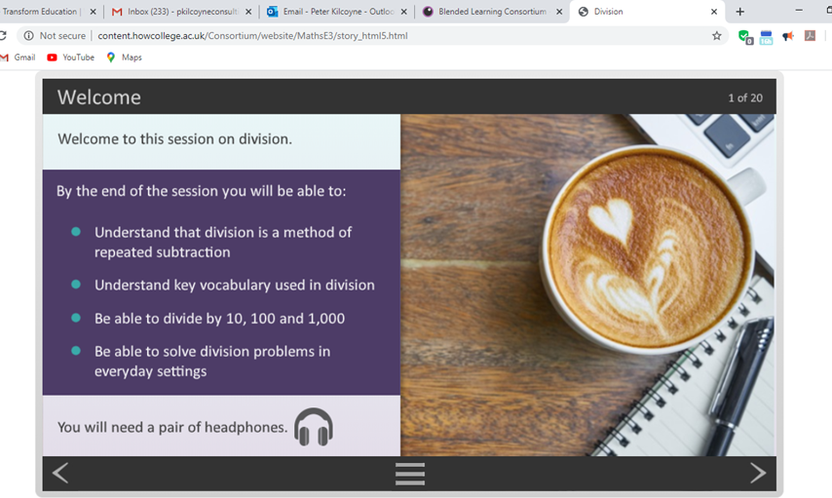
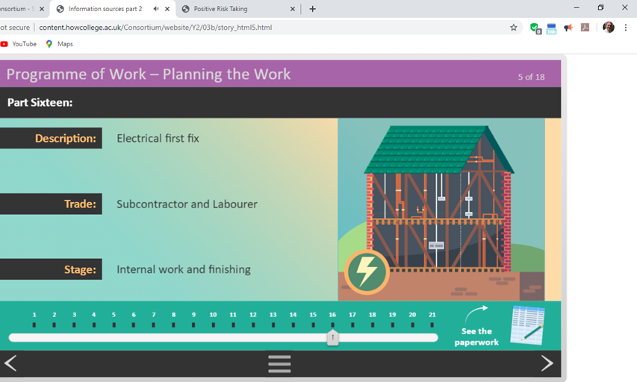
The right pedagogy
Content (e.g. BLC)
Collaboration and Communication
Digital Assessment (formative and summative)
Flipped learning

Slide 7

Effective CPD and ongoing support
Initial and ongoing CPD in digital tools and pedagogy
Share success stories and best practice
F2F, blended, online, webinar, weekly tips etc.
On-call support team
Allocated support

Slide 8
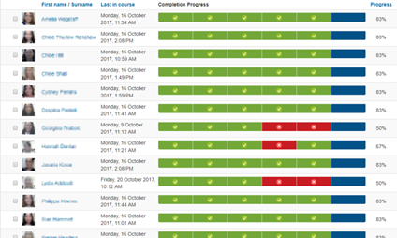
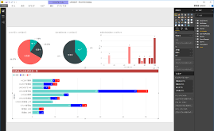
Monitoring participation and quality Equivalent to F2F teaching and learning
Track, monitor and challenge participation
Quality system to evaluated content, assessment and delivery

Slide 9

Clear roles and responsibilities
Management
Building online courses
Delivering and supporting online courses
Supporting teaching teams
Monitoring participation and responding to issues
Implementing quality system

Slide 10
Source: Paul A. Kirschner | @P_A_Kirschner
Notes:
What a potent analogy
Distance Teaching vs Emergency Remote Teaching. Distance teaching is where everything is planned and designed, the pedagogy is well thought out. Emergency teaching is like being in a war zone. Not to save lives but save learning.

Slide 11
What has worked well!
Pre-lockdown learner readiness Survey
Microsoft Bookings
1:1 feedback
Sessions are recorded
video feedback embedded onto the student’s OneNote feedback section
1:1 Tutorials
Run live office hours and respond to student questions and queries
Daily Student Check-in
Online Learner Agreement
Exemplar work video examples
Hold weekly live sessions called “Ask (Strong Student) Anything”
Self-assessment forms (as assignments)
Advanced students run support online sessions
Hold weekly live sessions called “Ask Teachers Anything”
A blend of (more) asynchronous (Video) and synchronous (Interactive, Live Q&A)
Class insights followed up with interventions
A pre-recorded weekly video

Slide 12
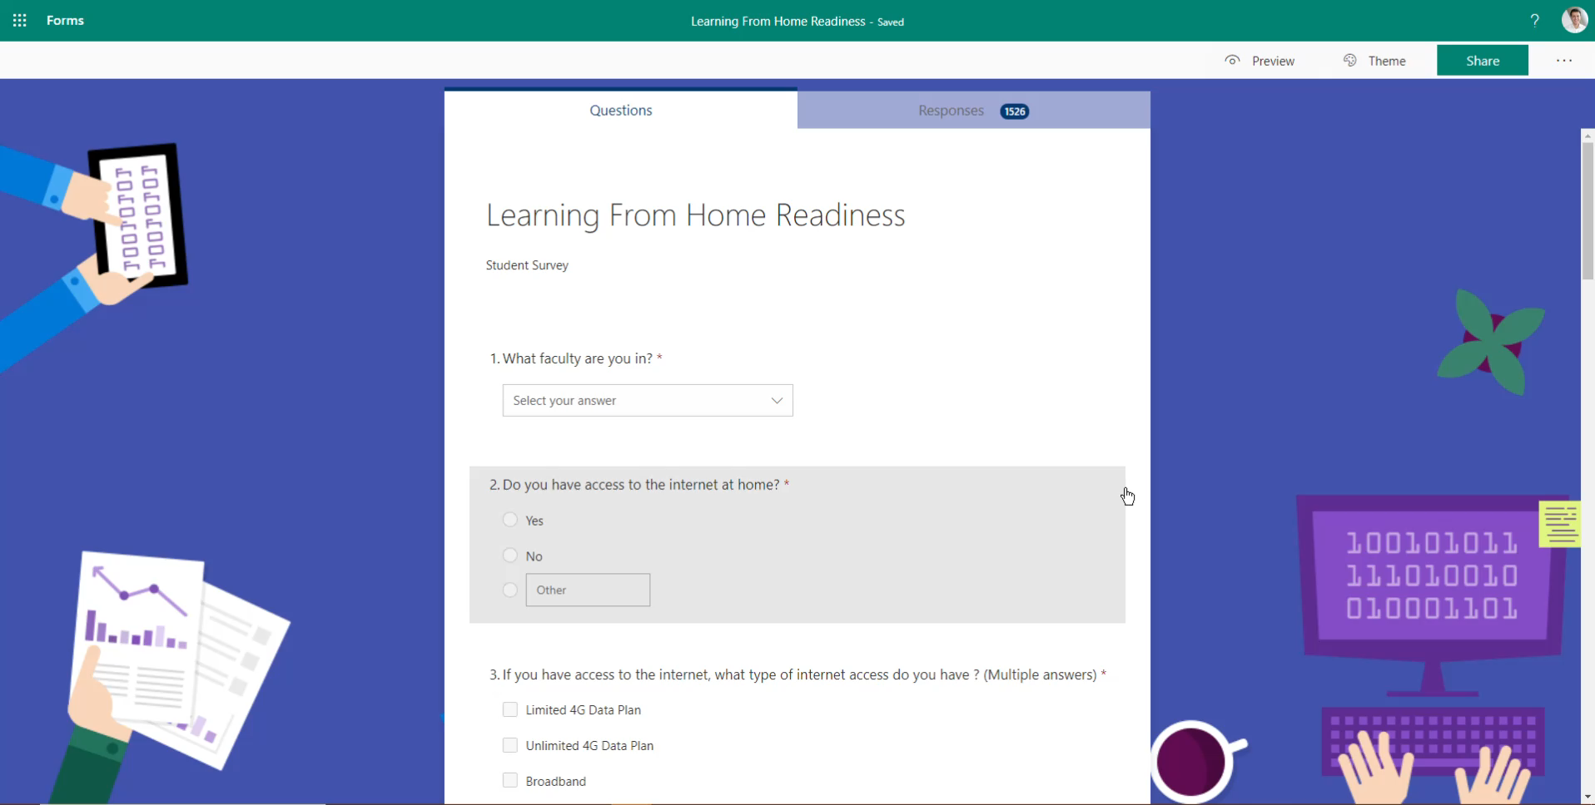
Pre-lockdown survey
Learning from home survey
Notes:
One thing that I'm very proud of at City of Westminster college is that we created a learning from home readiness Microsoft forms to identify any learners that do not have an Internet connexion or a device . We followed this up by sending dongles and devices to their home addresses to the best of our capability

Slide 13
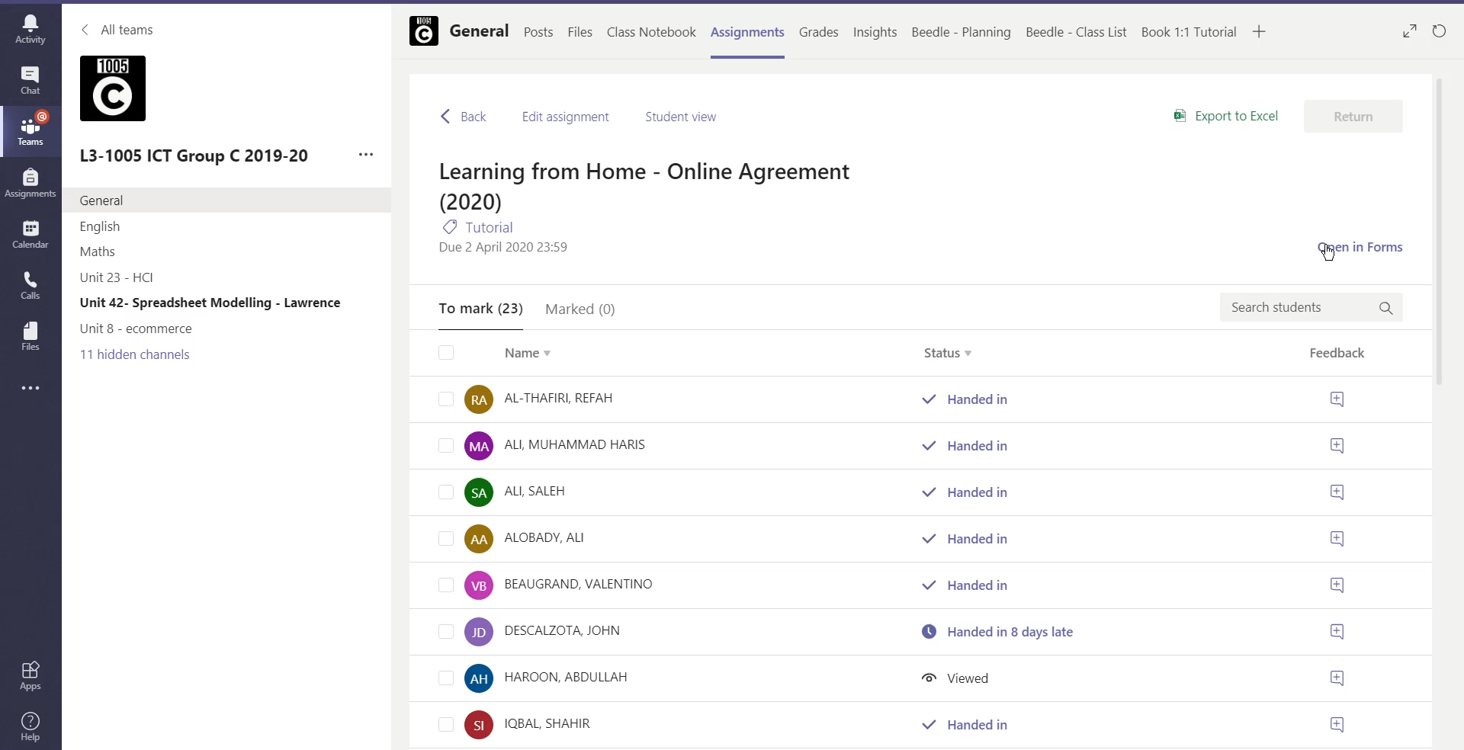
Learner Agreement
Notes:
It was important to create an additional online learner agreement so that students agree and adhere to a set of expected rules and behaviours online. We knew that the more use of teams the potential there was of the misuse of it such as online bullying

Slide 14
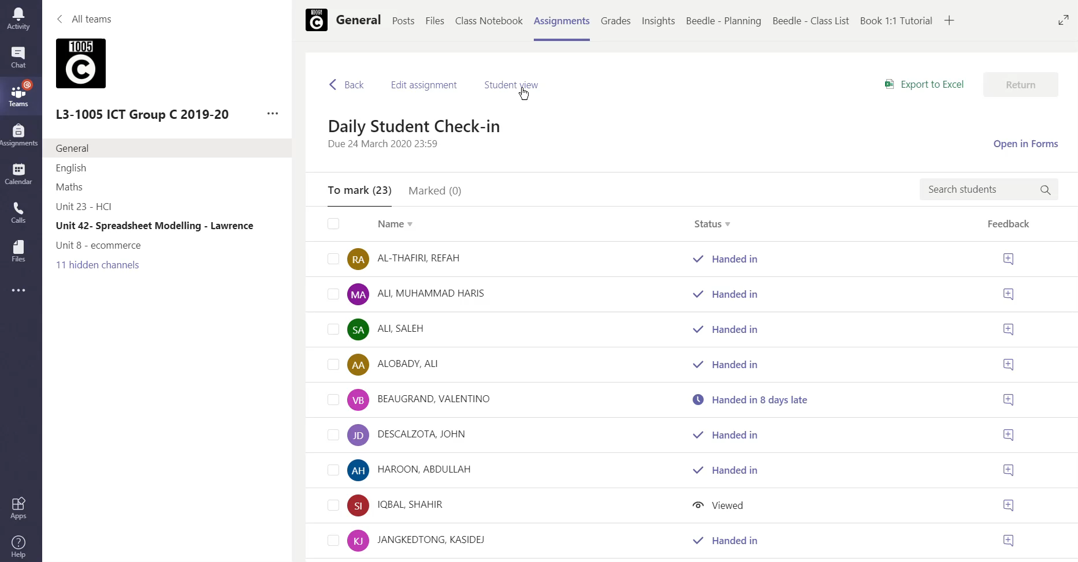
Daily Student Check-in
Notes:
Will we also used Microsoft forms as an assignment within teams to do a daily student cheque in to cheque on students and how they are coping mentally as well as with remote learning

Slide 15
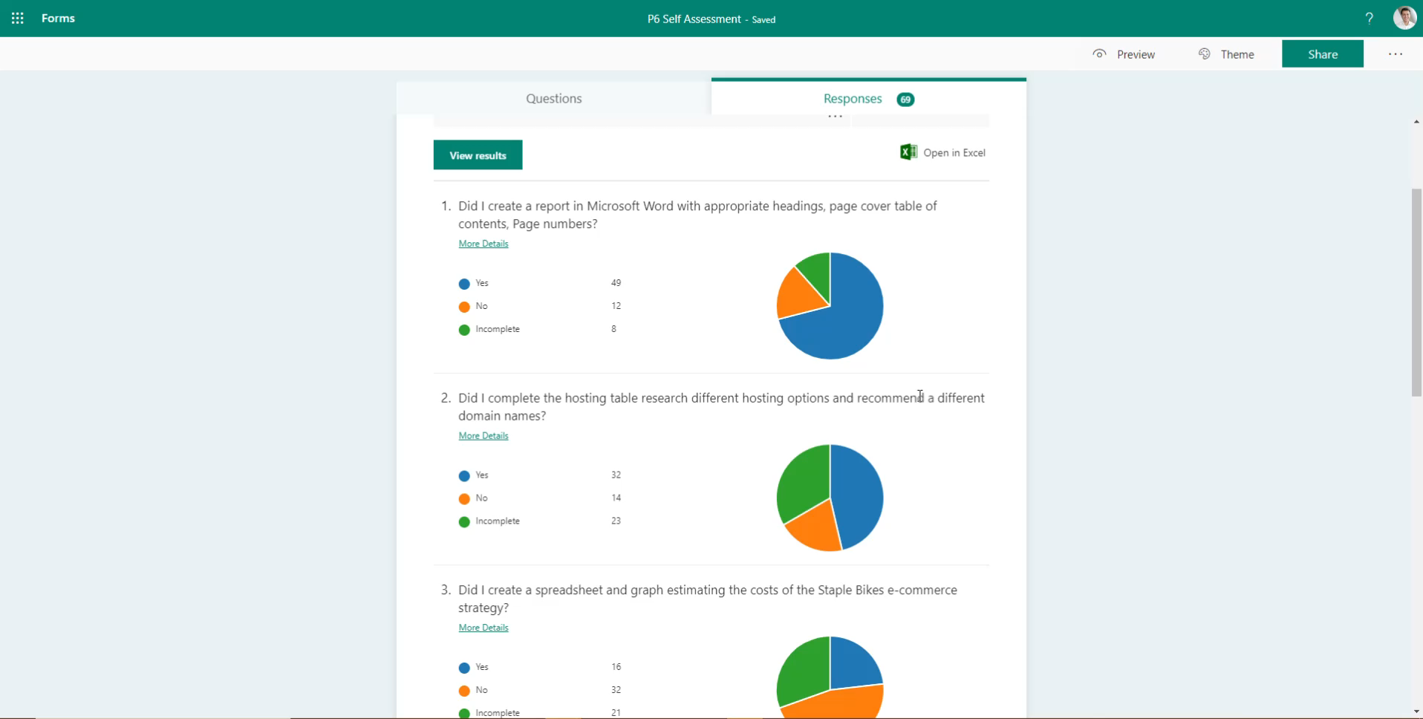
Student Self Assessment Forms
Notes:
In my opinion one of the best ways to reduce teacher workload and also put the emphasis on student independence was to create self assessment forms where students can assess their own progress and identify any missing work. This puts the onus and responsibility on students To track their own progress. The form uses branching so when a student identifies something as incomplete a calendar date will appear so then the student Will create their own deadline.

Slide 16
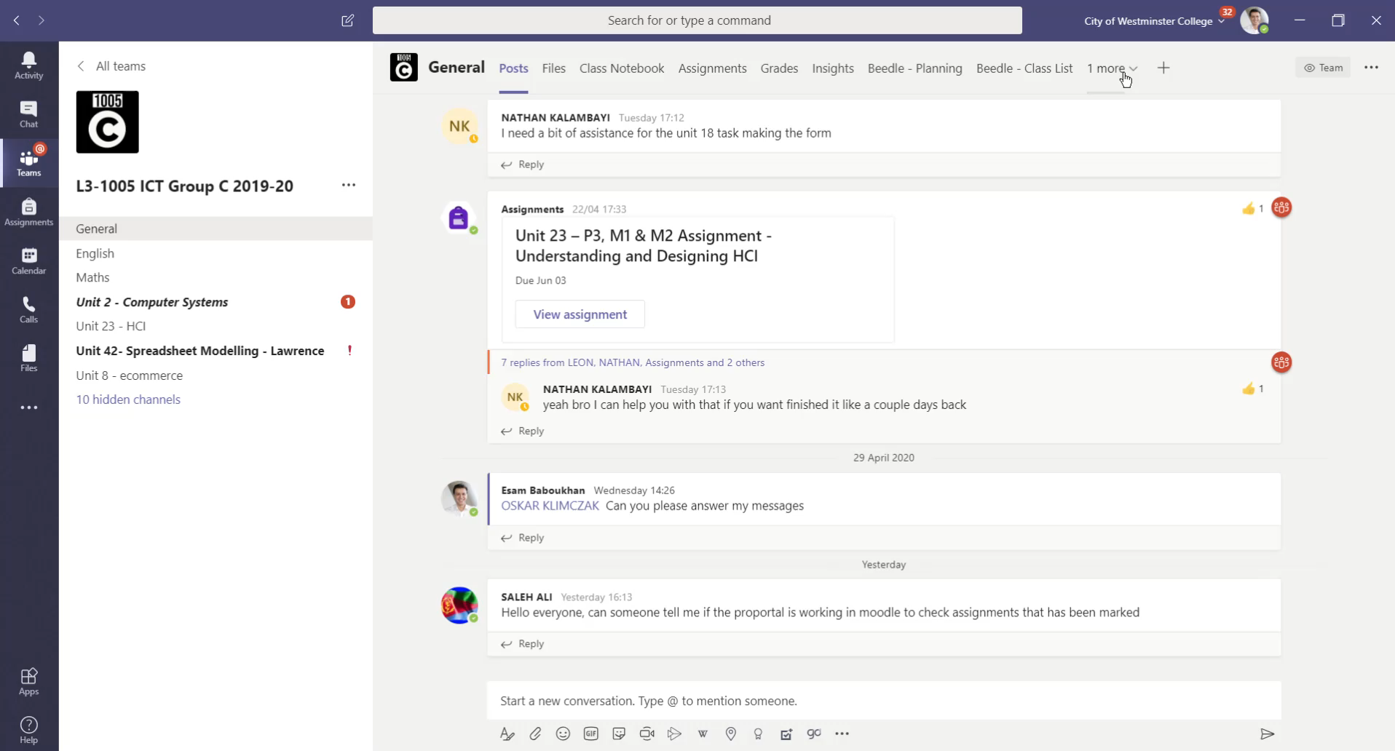
Microsoft Bookings for 1:1 feedback
Notes:
Out of all the strategies this is one that I will carry on with when we get back to some type of normality. As A teacher I don't get enough time to sit down with the students and give them 1:1 quality feedback . I teach a class for 60 minutes. In that time I need to deliver a lesson and it can be quite difficult to dedicate that time to my 20 or so students, something always comes up. Using Microsoft bookings within Teams has allowed students now to book 121 online meetings with me. The students book a time that I'm available and the system does it all and then I get sent a meeting link for us to meet online. The sessions are recorded using Microsoft stream and we share screens where I give them feedback on their work and at the same time if they passed the criteria I update their grades on the system. The stream feedback video is then sent to their feedback sections in OneNote for them to review

Slide 17
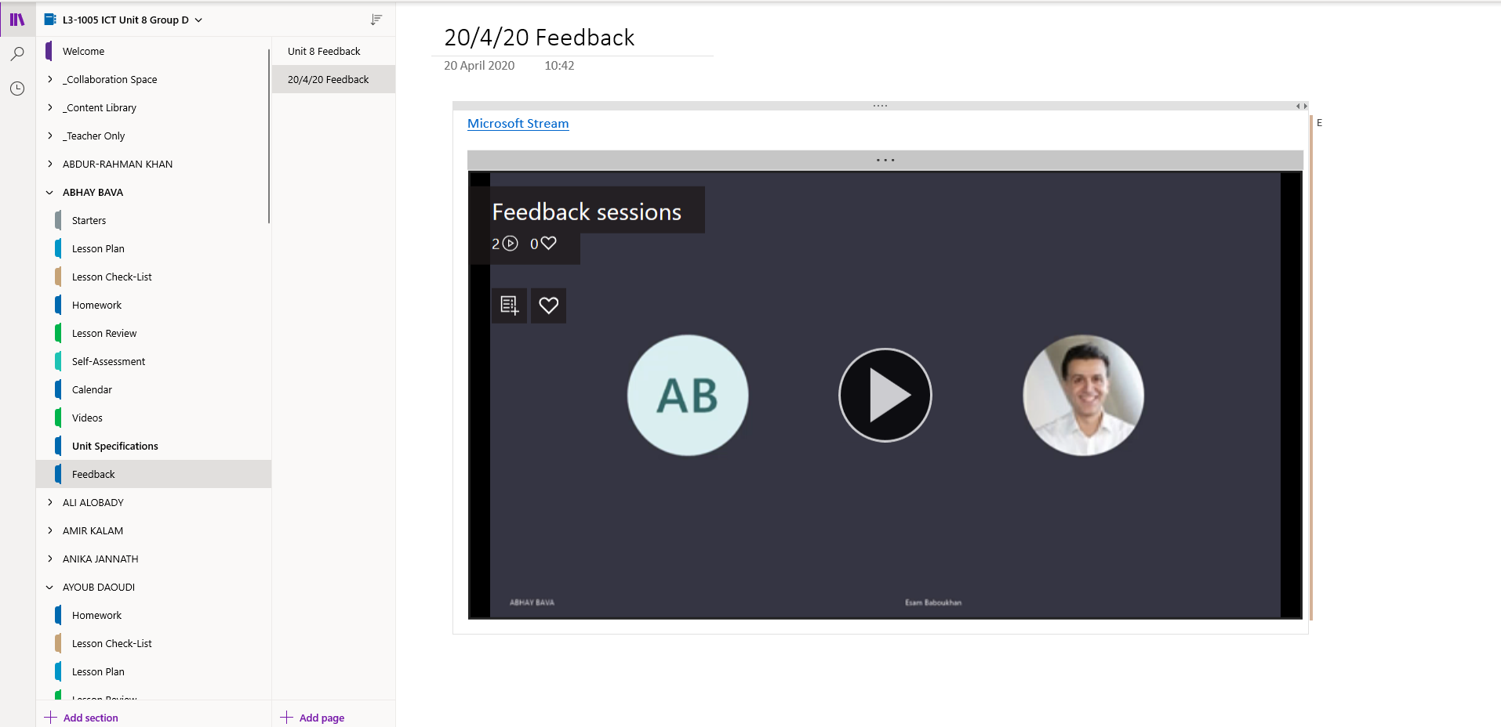
Video feedback linked in OneNote

Slide 18
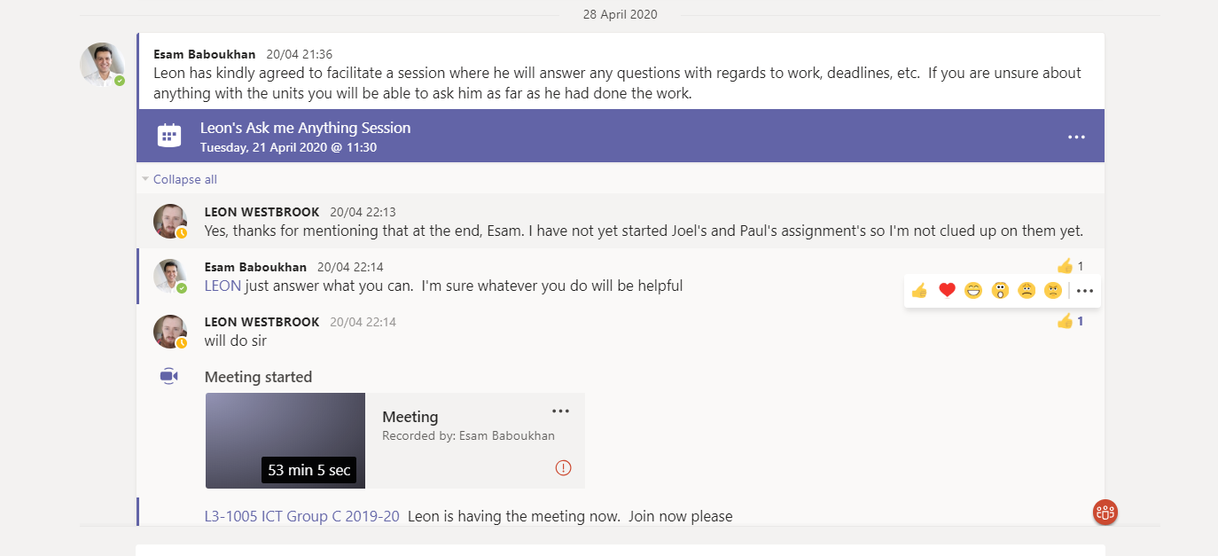
Peer to Peer teaching

Slide 19
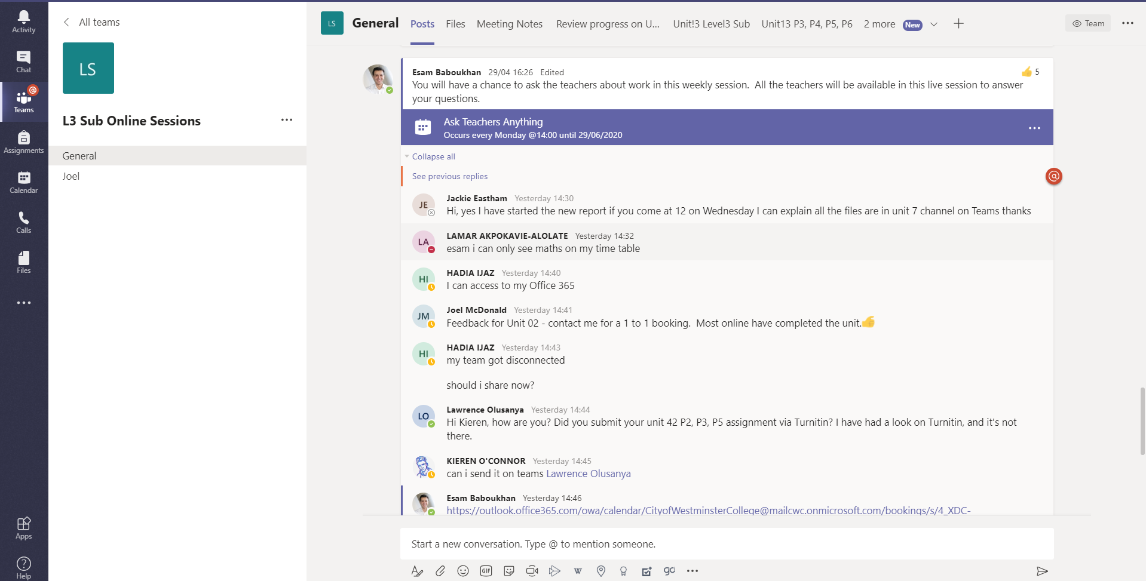
Ask Teachers Anything sessions
Notes:
This is proving to be very popular we've created a weekly meeting session with all the teachers available to answer any of the students questions and queries . It's also an opportunity for the teachers to communicate with all the learners about work deadlines and also some of the latest developments regarding our situation

Slide 20
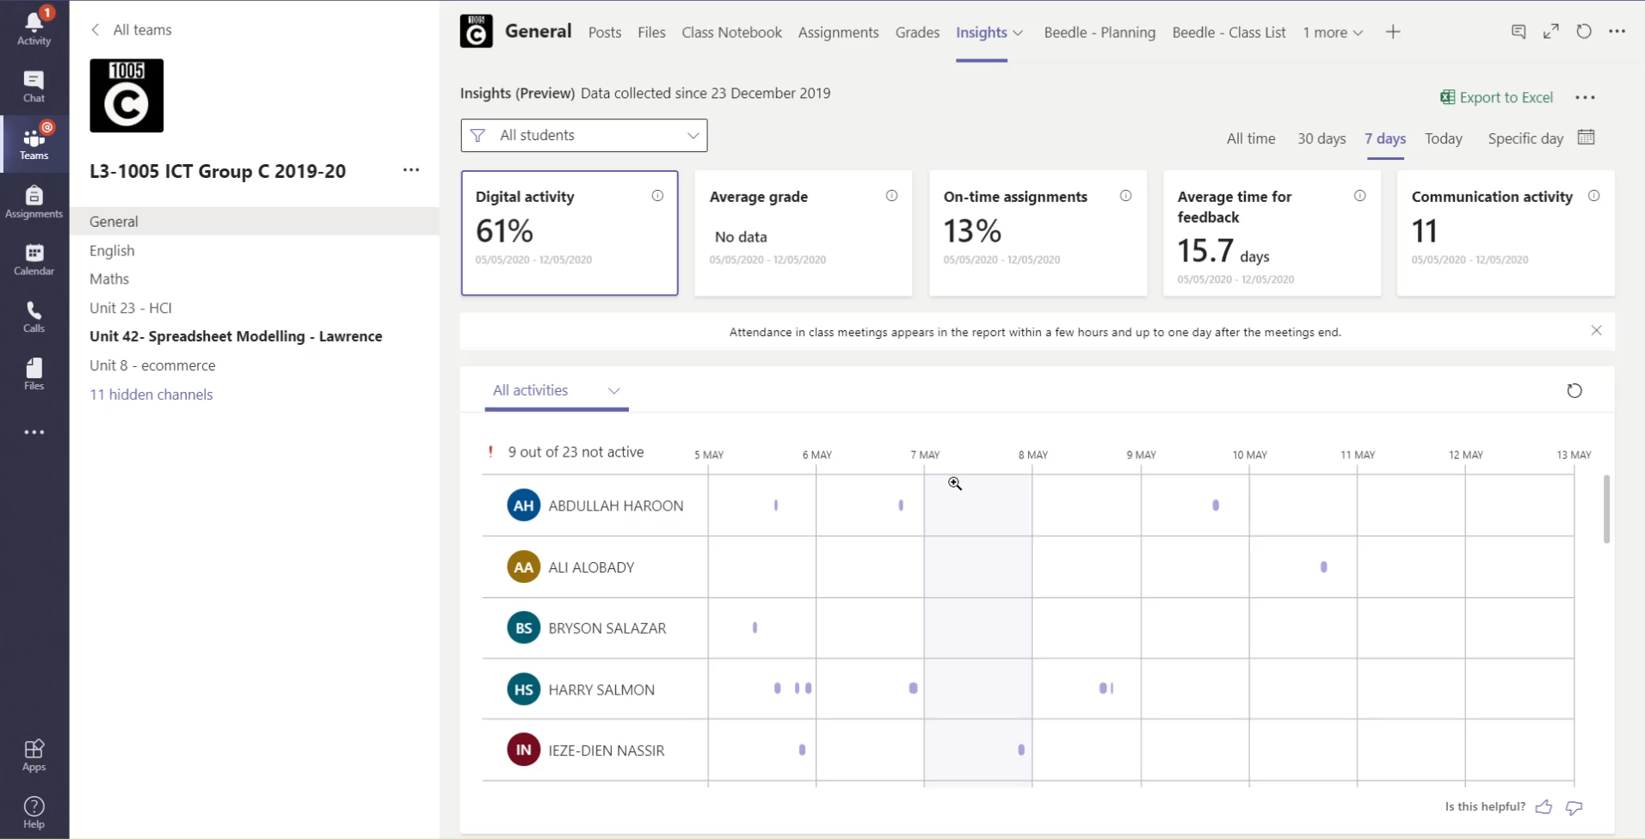
Class Insights
Notes:
Class insights has become an incredibly important tool in remote learning. We are able to identify students that are not participating. We can then follow this up using various interventions, one that we have in the college is highlighting their names at the end of the week for the appropriate people then to follow this up by calling them on the phone .

Slide 21

The genie is out of the lamp
Notes:
And finally what I would like to say is that the genie is out the lamp . I don't think we're ever going to go back to the way things were . I think we will come back stronger and better and as I like to keep repeating to everyone that with every crisis lies opportunity
The future Online learning and blended learning and what you it look and feel like really depends on who is rubbing the lamp is it jabarr or Aladdin .

Slide 22
How can Transform Education support you?
CPD Online, blended or F2F CPD from our Directors and Associates
Microsoft 365 Microsoft Global Training Partner offering a full range of advice, support and training on making the most of Microsoft 365
Consultation Advice on implementing a successful blended curriculum in the new normal
A new learning platform? LMS365 – a high quality user friendly VLE based around Microsoft 365 Apps

Slide 23
More information
https://transformeducation.co.uk/
peter@transformeducation.co.uk

